Slide 1
Adaptive Jamming-Resistant Broadcast Systems with Partial Channel Sharing (ICDCS ‘10)
Qi Dong and Donggang Liu
Presented by Ying Xuan

Slide 2
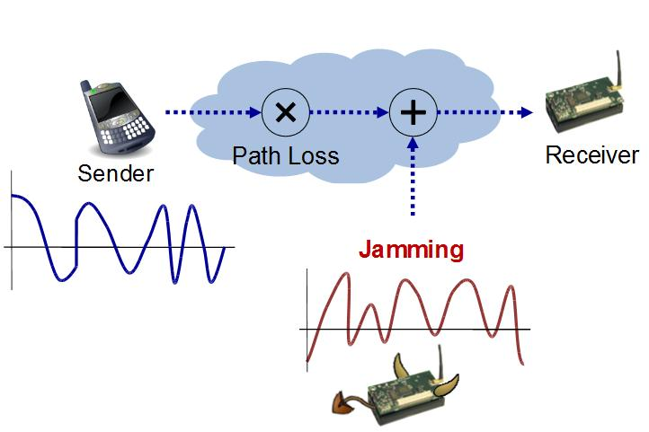
Problem Definition
Jamming Attacks to wireless communications
Jammer injects interfering signals, significantly reducing SNR at the receiver.
Hard to locate the jammers.

Slide 3
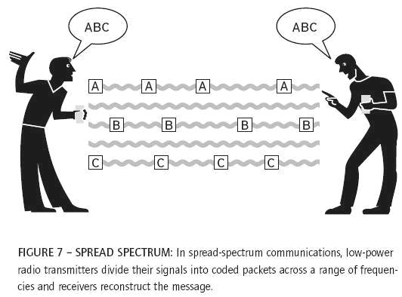
Existing Solution
Spread Spectrum
Spread the signal over a larger bandwidth
Expensive for the jammer to search for the currently “used” frequency

Slide 4
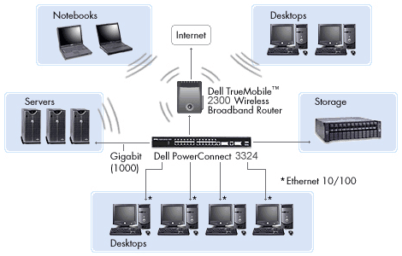
Deficiency
Broadcast Communication
Attacker can compromise one receiver
The channel information is exposed

Slide 5
Group-based scheme
Multiple-group multiple frequencies
Divide receivers into multiple groups
Different channels for different groups
Use divide-and-conquer to isolate compromised receivers.
Each group needs a separate copy of each broadcast message.

Slide 6
Partial channel sharing
Each channel is divided into multiple smaller ones.
Different groups partially share these channels
Groups share the data copy through the shared channels.
Pro: much less communication cost
Con: if attacker jams the shared channels….
Object
minimize the message complexity
and isolate the malicious receivers.

Slide 7
Model and Parameter Setting

Slide 8
Binary Search Algorithm
detect the traitors in the trusted
group
partially share channels between
suspicious group pair
detect untrustworthy group in a
group pair
identify and remove traitors

Slide 9
Decision Variables

Slide 10
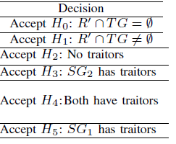
Performance Analysis
False rate by the system parameters
Performance with worse-case (tricky attackers)
part 1: no traitors, one group containing traitors, both groups containing traitors
part 2: how long will the attacker hide themselves
part 3: communication overhead

Slide 11
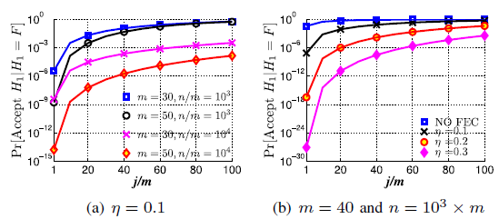
If no traitor, how likely does the attacker succeed in blocking the communications

Slide 12
Hypotheses translation

Slide 13
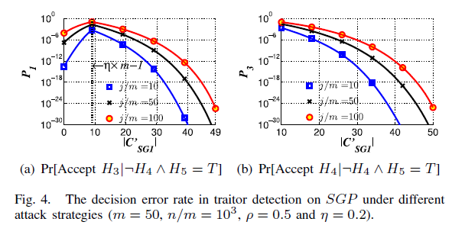
Tricky Attackers
No traitors
Only one group contains tractors
Strategy: jam channels in one group, and spend the rest energy for the other group

Slide 14
Only one group contains tractors

Slide 15
How long will the attacker survive
given compromised receivers

Slide 16
Communication Overhead
As increases, the proportion of the shared channel increases, and the false rate increases too. But it is not that perfect, what to do next?

Slide 17
Need more precise decision
Risk function, where is the variable for # of obervations collected
Use Lai’s Bayes Sequential Test to make decision at each observaton (sub-test)

Slide 18
False Rate and Decision Making Rate

Slide 19
The End

